Slide 1
The Value Set Authority Center
Information Modeling and Semantic Interoperability Forum
Steven Emrick
Head, Terminology QA & User Services
National Library of Medicine
steve.emrick@mail.nih.gov

Slide 2
Overview
What is VSAC and why is it important?
Authoring and collaboration
Future directions:
VSAC on FHIR
Collab-athon
Bindings

Slide 3
VSAC – the Value Set Authority Center:
NLM hosts the VSAC to support the creation and distribution of value sets that serve to define clinical concepts, such as ‘bipolar disorder’, or ‘current tobacco smoker’. These value sets are often enumerated with codes from vocabulary standards supported by NLM (and mandated by Meaningful Use), such as SNOMED CT, RxNorm, and LOINC. These value sets are in turn used by quality measures, patient summary documents, forms, etc.

Slide 4
Example: ‘Body Site’ value set,
As defined in C-CDA
Over 30k concepts!!
Notes:
An example value set.

Slide 5
VSAC – provides:
Source of truth for value set definitions
Downloadable expansions (actual lists of codes)
An API (based on an IHE standard – moving towards FHIR)
Authoring and collaboration environment
Duplicate content checking (based on Jaccard overlap)
Warnings for inactive/obsolete codes
Checking for invalid codes

Slide 6
Value Set usage ‘pie chart’ circa 2012:

Slide 7

What other stewards/programs are creating content in VSAC?

Slide 11
VSAC Ecosystem
Terminology (SCT, LNC, RxNorm, UMLS, etc)
Provide Feedback
SOLR??
Collaborate
Author
Repository
publish
Request Feedback
Request Expansions
/validations, etc
Collaborators/SMEs
Authors
Consumers/Reference Implementations

Slide 12
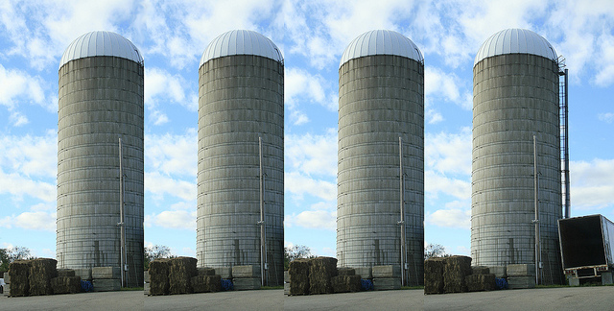
Value Set Development – until very recently
Notes:
Value sets are often created through disparate contract vehicles or in separate institutions, and there is very little incentive or tooling to support collaborative review of content during the authoring process. This has sometimes resulted in the creation of highly duplicative, erroneous, or incomplete value set content. This in turn, results in an unnecessary burden on implementers in terms of content acquisition and maintenance.

Slide 13

What is the Purpose of VSAC Collaboration?
Why collaborate?
VSAC authors need tooling that supports more interactive and centralized collaboration and discussion during the development process. The goal is to reduce development of duplicative and erroneous content, and to improve the overall quality of value sets through a process of social curation.

Slide 14
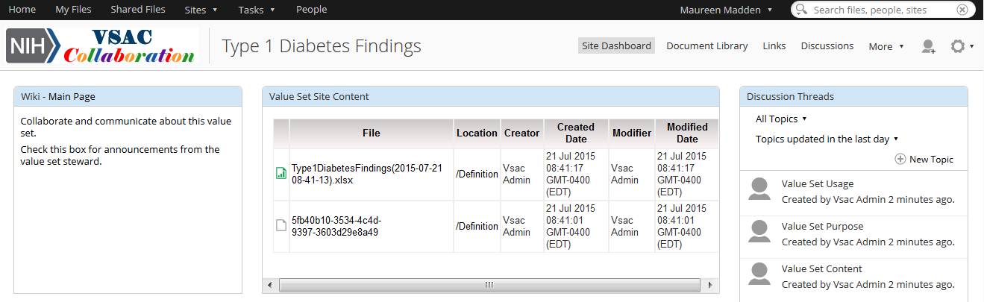
View Documents within a Value Set’s Collaboration Content Site

Slide 15
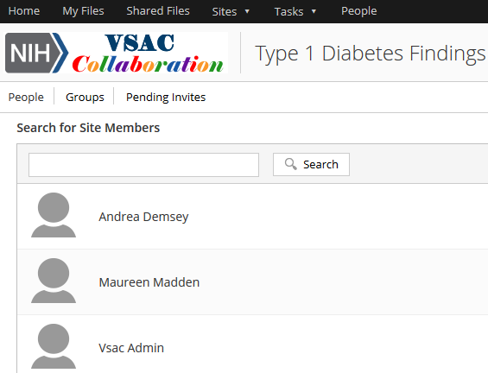
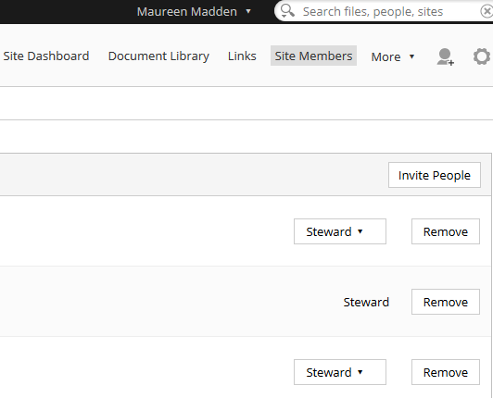
Invite Additional Collaborators to Your Value Set Collaboration Site
Notes:
Value set authors can invite others to review their content.

Slide 16
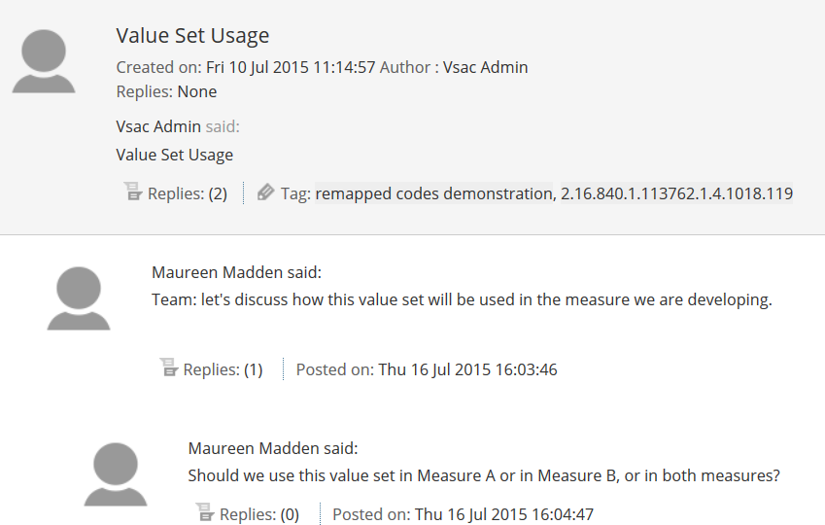
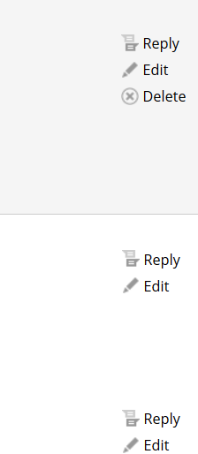
All Site Members Can Participate in Discussion Forums and Create New Topics
Notes:
Collab comes with three default discussion topics we have made for you: Usage, Purpose, Content
Make a comment
Reply to a comment
Create a new topic

Slide 17

VSAC Collab-athon
VSAC Collab-athon
Provide users the opportunity to test various collaborative scenarios such as inviting SMEs to collaborate, document upload, and review/issue tracking.

Slide 18

VSAC - Future Directions
Alignment with FHIR and VSD
Publish more C-CDA value sets
Binding Parameter Specification
Collab-athon
Integration with CDE repository

Slide 19
VSAC – beyond Clinical Quality Measure Value Sets
Many C-CDA value sets are in VSAC or going into VSAC now to support implementation.
Some of these value sets are very large and potentially burdensome for individual sites to generate/maintain on their own. VSAC can provide an always-up-to-date expansion of these value set definitions.
Examples:
SNOMED CT ‘Findings’ value set > 105k concepts
SNOMED CT ‘Body site’ value set > 30k concepts
RxNorm ‘Medication Clinical Drug/Brand Name’ > 30k concepts each
These large value sets really act as ‘filters’ (am I using a code from the right part of the vocabulary?), but nonetheless the community needs validation and expansion support.

Slide 20
VSAC – Future Directions with FHIR
FHIR provides:
Lingua franca to meet many of the use cases surrounding value set conformance, such as code lookup, value set expansion, and code validation within a value set.
This supports conformance and testing – for example, ‘is this drug code presented to my system in a C-CDA document part of the RxNorm medications value set?’
These common operations can be applied to any value set, including those defined by C-CDA, FHIR, CQMs etc.
VSAC provides:
Source of truth for CQM, C-CDA, and other value set definitions.
Updates to terminologies (SNOMED CT, RxNorm, LOINC, etc) that are used by the value sets.
Authoring tools that allow value set creators to create definitions and discuss their value set content with a community.

Slide 21
UMLS and other vocabs
VSAC
FHIR $expand, $validate
EHR System
EHR System
C-CDA messages

Slide 22

VSAC Future Directions: Model Bindings
Authors need a (standards-based) way within VSAC to assert model or usage bindings to value sets.

Slide 23
NLM CDE Repository – https://cde.nlm.nih.gov

Slide 24
VSAC OID

Slide 26
Questions?
Steven Emrick
steve.emrick@nih.gov
Subscribe to our listerv:
NLM_VSAC_UPDATES@LIST.NIH.GOV

